Slide 1
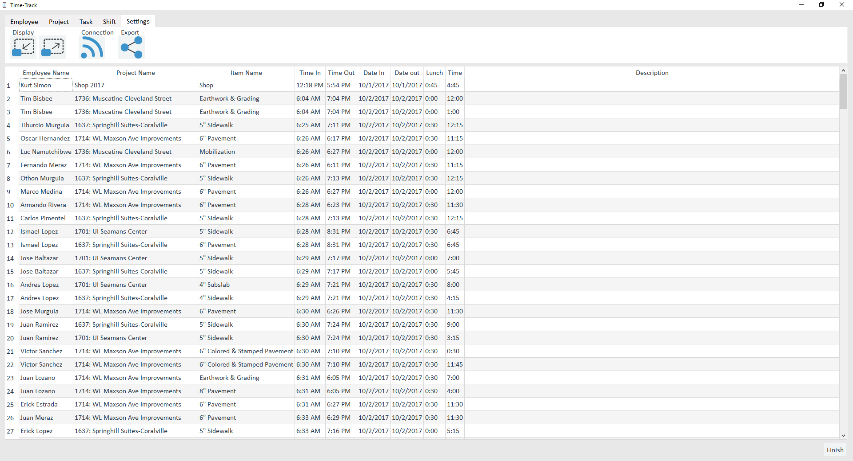
Step 1:
Select export from the admin menu

Slide 2
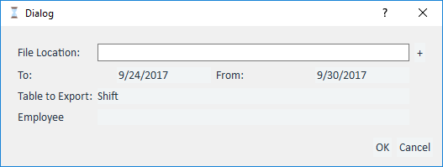
Step 2:
Choose a file location
Choose a date range(the default is the last complete week)
Choose ‘Shift’ or ‘All Shifts’
If you choose ‘Shift’ the select an employee from the dialog below.
Step 3:
Press Ok!

Slide 3
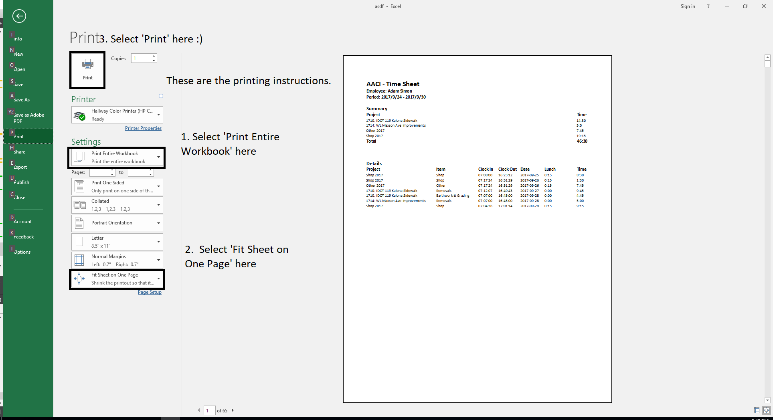
Step 4:
Follow instructions to the left to print the workbook.

